Slide 1
Prof. Christopher B. Barrett Cornell University Spring 2021 Research Symposium on “The intersection of food systems, policy, and nutrition research” National Institutes of Health T32 Nutrition Training Program June 2, 2021
Translation Food Policy Research:
Some Insights

Slide 2
Background
Food security is a human right (Art. 25 1948 UDHR), intrinsic to human flourishing
Food security exists if and only if
“all people at all times have physical, social, and economic access to sufficient, safe and nutritious food that meets their dietary needs and food preferences for an active and healthy life”
(1996 World Food Summit definition, emphasis added)

Slide 3
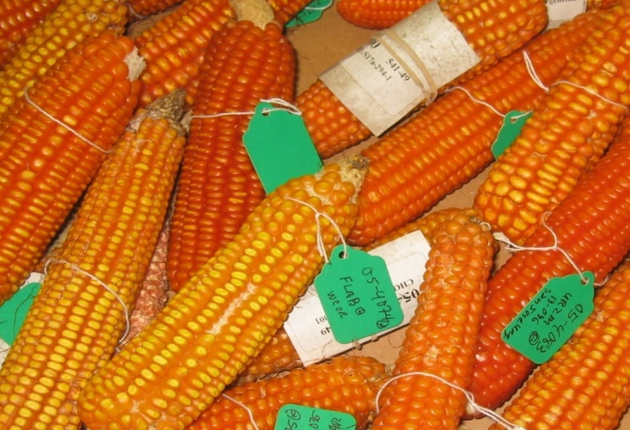
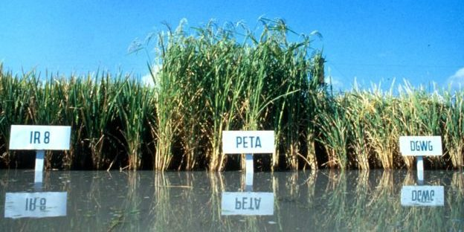
Policy responses
For most of history, the primary response has been on supply side: boost food production (e.g., Green Revolution) or improve food quality (e.g., salt iodization, biofortification, RUTFs)
Photo credits: Edesia, IRRI, Mike Gore

Slide 4
Policy responses
But starting in ~1970s/80s, gradual realization that food availability is necessary but not sufficient to food security. Food access is key. Heavily driven by policy. And research can improve policy.
“Starvation is the characteristic of some people not having enough food to eat. It is not the characteristic of there being not enough food to eat.” (emphasis in original)
- Opening sentences, Amartya Sen, 1981 Poverty & Famines
Policy reforms to ensure food access at all times become central:
Right to work and scalable EGS (e.g., MGNREGS in India)
Conditional transfer programs (e.g., Progresa in Mexico, PSNP in Ethiopia)
Gov’t food assistance programs (cash or in-kind)
Humanitarian food assistance: EW/targeting, shift from “food aid”

Slide 5
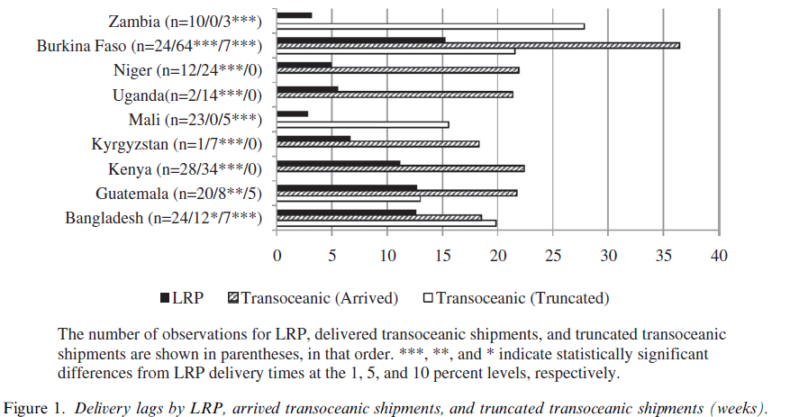
Research to inform
policy advances
Ex 1: 2008 Local and Regional Procurement (LRP) Pilot Program
Created by 2008 Farm Bill based on researcher recommendations.
Cornell-NGOs research partnership (LRP Learning Alliance) established:
LRP reduces delivery delays by 14 weeks
Source: Lentz, Passarelli and Barrett (WD 2013)

Slide 6
Research to inform
policy advances
2008 Local and Regional Procurement (LRP) Pilot Program
LRP reduces costs of basic grains by 50% (but not processed foods)
Has no effect on price levels or volatility in procurement markets
Is preferred by recipient consumers over foods imported from US
At least comparable quality/safety to US products
Can benefit smallholder farmer suppliers
Conclusively answered questions that lingered during the 2008 Farm Bill debates ... White House invoked the findings for 2014 Farm Bill clinching several policy debates (but lost the political ones!).
(See Lentz et al. Sep. 2013 World Development special issue)

Slide 7
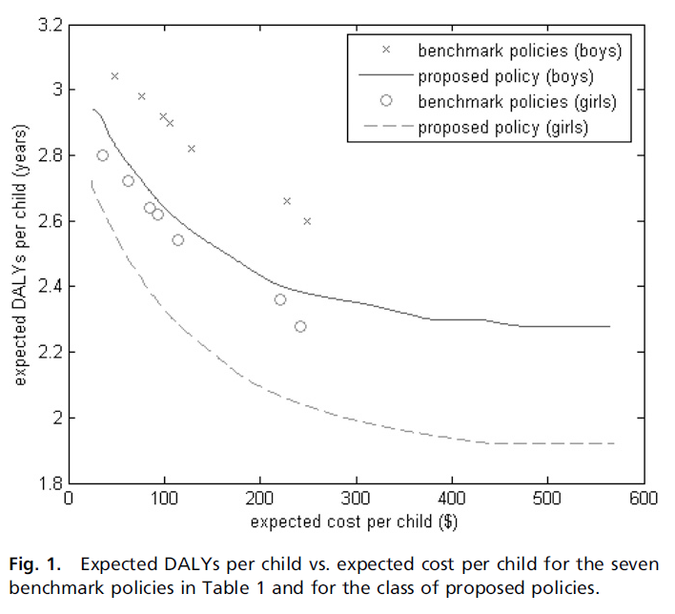
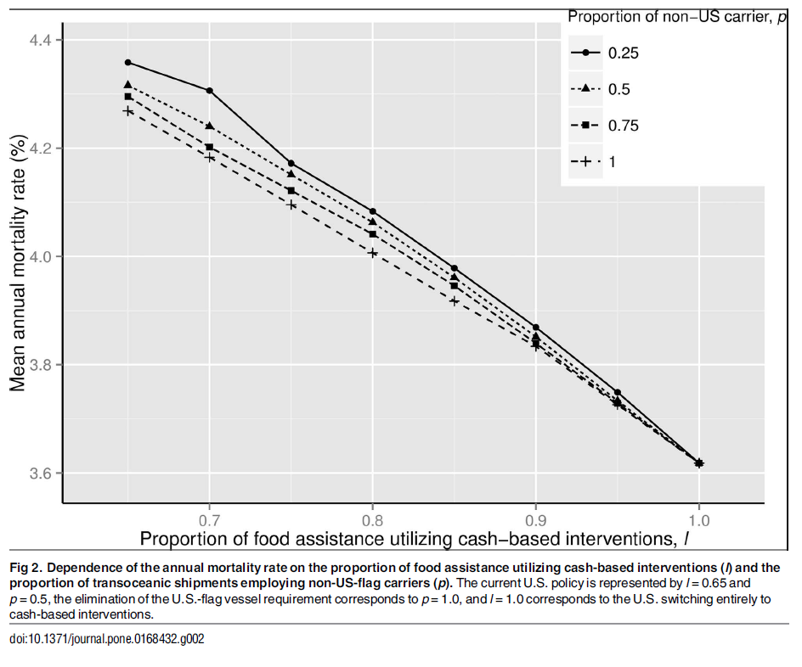
Research to inform
policy advances
Subsequent analyses show cash and RUTF interventions, targeting on both HAZ and WHZ, relaxing cargo preference can save children’s lives. Helps influence humanitarian food assistance programming.
(Sources: Yang et al. PNAS 2013; Nikulkov et al. PLoS ONE 2016)

Slide 8
Research to inform
policy advances – a caution
Seemingly clever research that’s wrong can do damage.
Example: Nunn and Qian (AER 2014) claim US wheat food aid shipments cause longer, more deadly conflict in recipient countries. Widely reported/discussed; hugely important, if true.
Problem: They mischaracterize US food aid policy. But a model with proper timing and subsamples yields the same result … why?
Deeper (and underappreciated) econometric problem: panel IV estimation vulnerable to spurious regressions due to common cycles in time series component.
Finding: Once one accounts for the trends, NQ results disappear. Indeed, NQ results perfectly consistent with a model in which food aid reduces conflict.
(Christian and Barrett in review)
Use research credentials judiciously and subject work to good peer review.

Slide 9
Summary
Empirical food policy research can – and has – significantly influence food policy. Good research matters! (And bad research can cause damage.)
Key takeaways:
Work in partnership w/operational agencies
Focus on rigor of work and subject research to most intense peer review feasible.
Once confident of results, translate into terms policymakers/ influencers understand (e.g., 40K children’s lives per year as the cost of US food assistance policy oddities).
Prepare for disappointment. Politics dominates evidence.

